Slide 1
Crazyfiles Install Tutorial

Slide 2

Cfclient
https://github.com/bitcraze/crazyflie-clients-python/blob/master/docs/installation/install.md
pip3 install --upgrade pip
git –version
pip3 install cfclient
git clone https://github.com/bitcraze/crazyflie-clients-python
cd crazyflie-clients-python
pip3 install -e . Do these everytime
cfclient

Slide 3
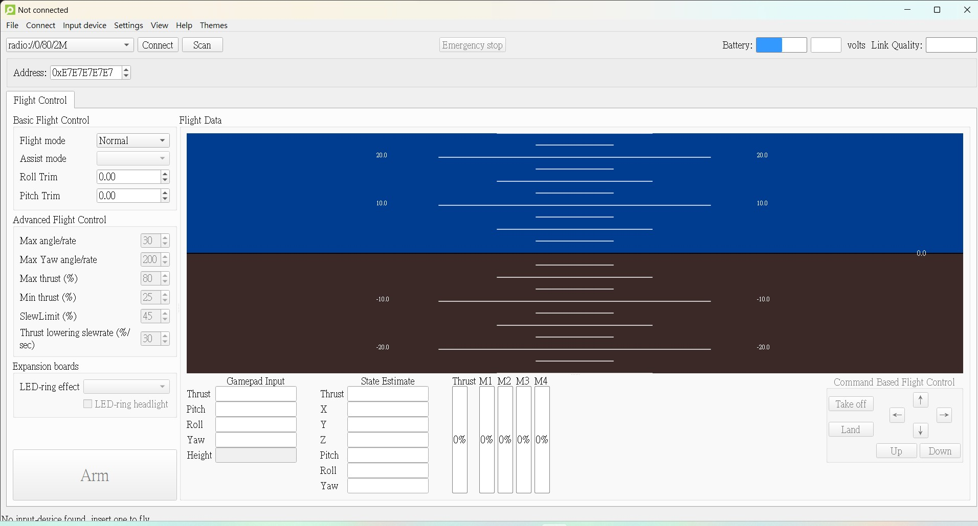
Radio Channel Build
①②③④
②
①
Choose Channel

Slide 4
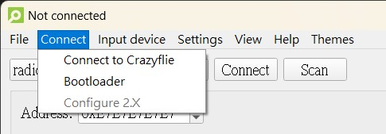
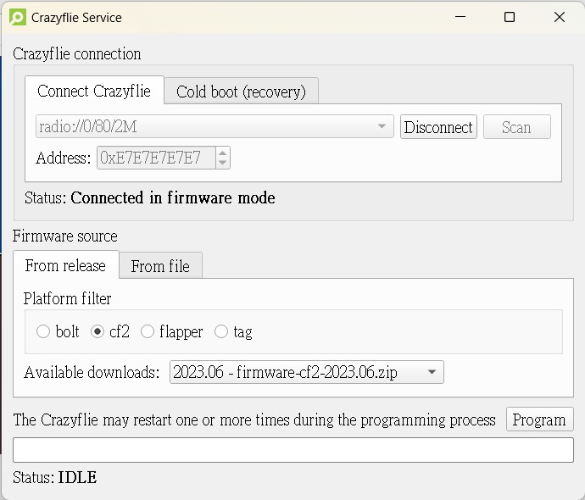
Radio Channel Build
①
Connect first
②
Choose the newest version
③

Slide 5
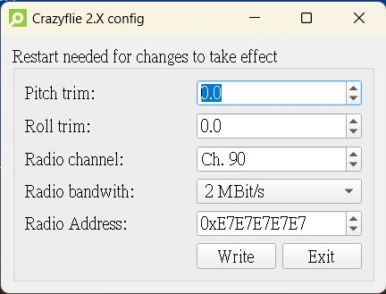
Radio Channel Change
②
①
Connect first
③
Change the number

Slide 6
AI Deck Build (先拔掉flow deck)
①②③④
②
①
Choose Channel

Slide 7
AI Deck Build (先拔掉flow deck)
①
Connect first
②
Choose the newest version
③

Slide 8
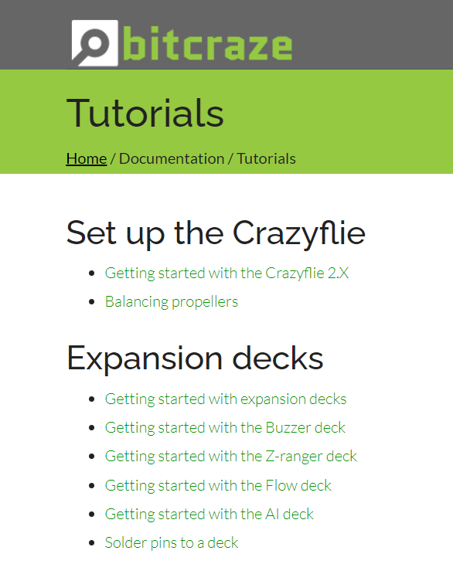
AI Deck Build(Gap8 bootloader)
git clone https://github.com/bitcraze/aideck-gap8-bootloader.git
cd aideck-gap8-bootloader
cfloader flash aideck_gap8_wifi_img_streamer_with_ap.bin deck-bcAI:gap8-fw -w radio://0/90/2M/ (choose the correct channel)

Slide 9
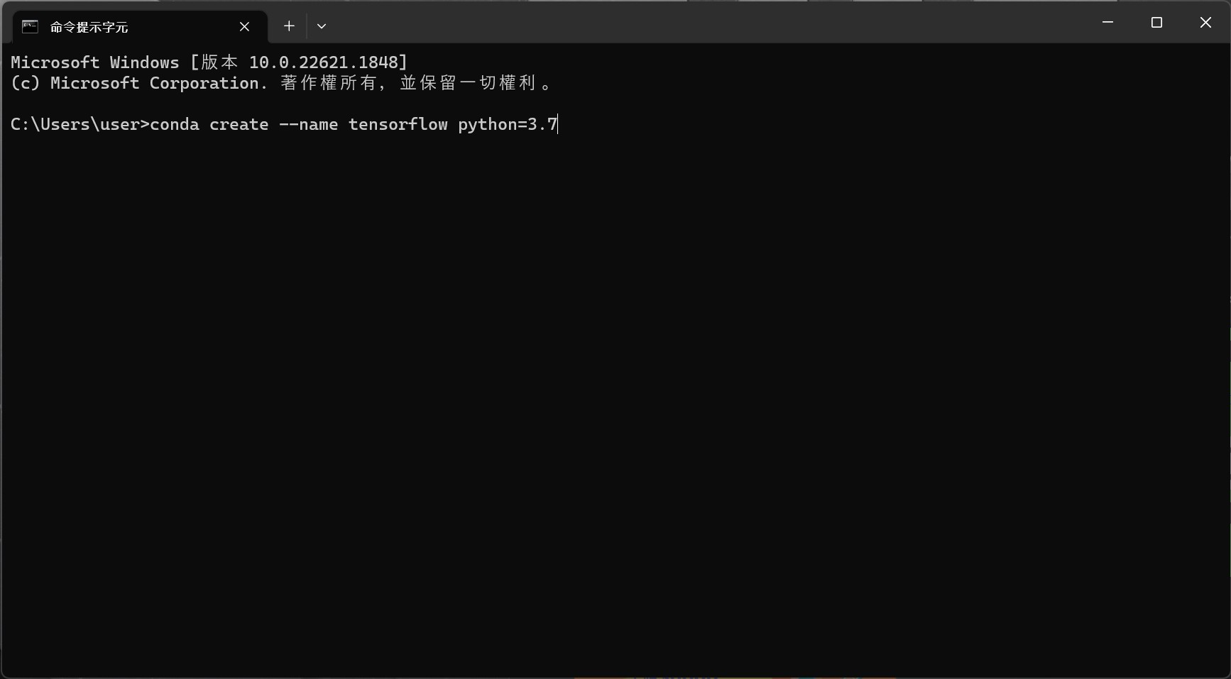
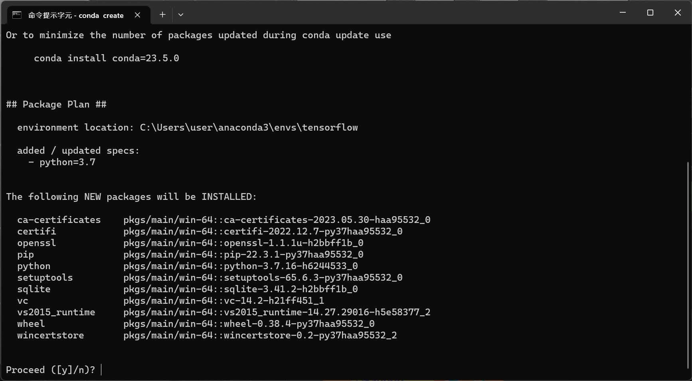
Tensorflow GPU Setup
Using cmd
conda create --name tensorflow python=3.7
輸入y

Slide 10


Tensorflow GPU Setup
2. Conda activate env_name(進入環境)
3. Conda install tensorflow-gpu==2.5 (not tensorflow)

Slide 11
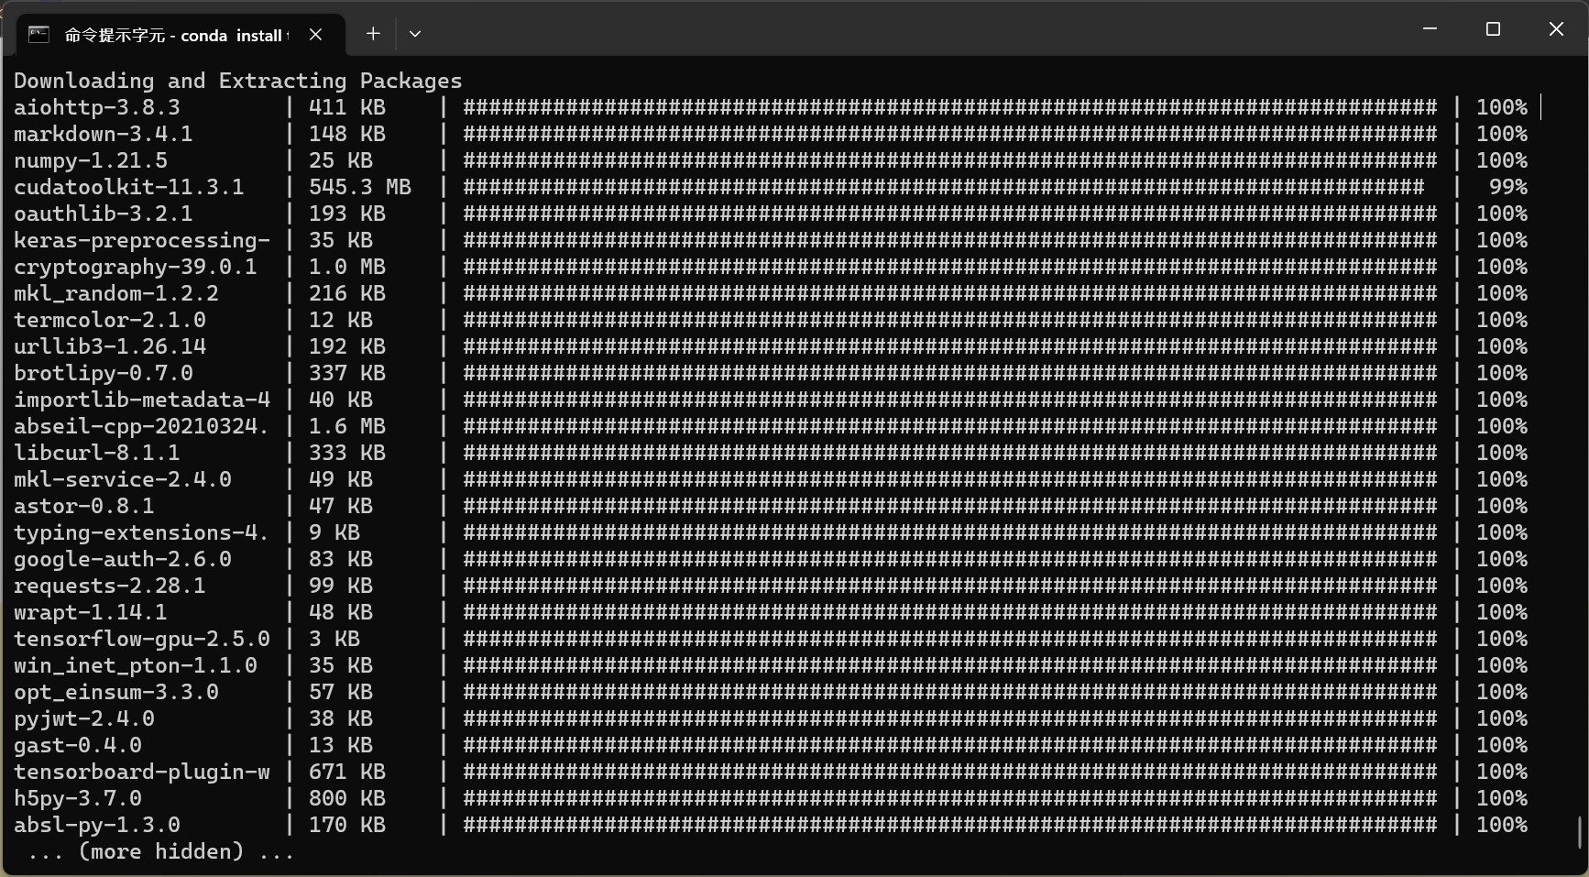
Tensorflow GPU Setup
Waiting for download

Slide 12
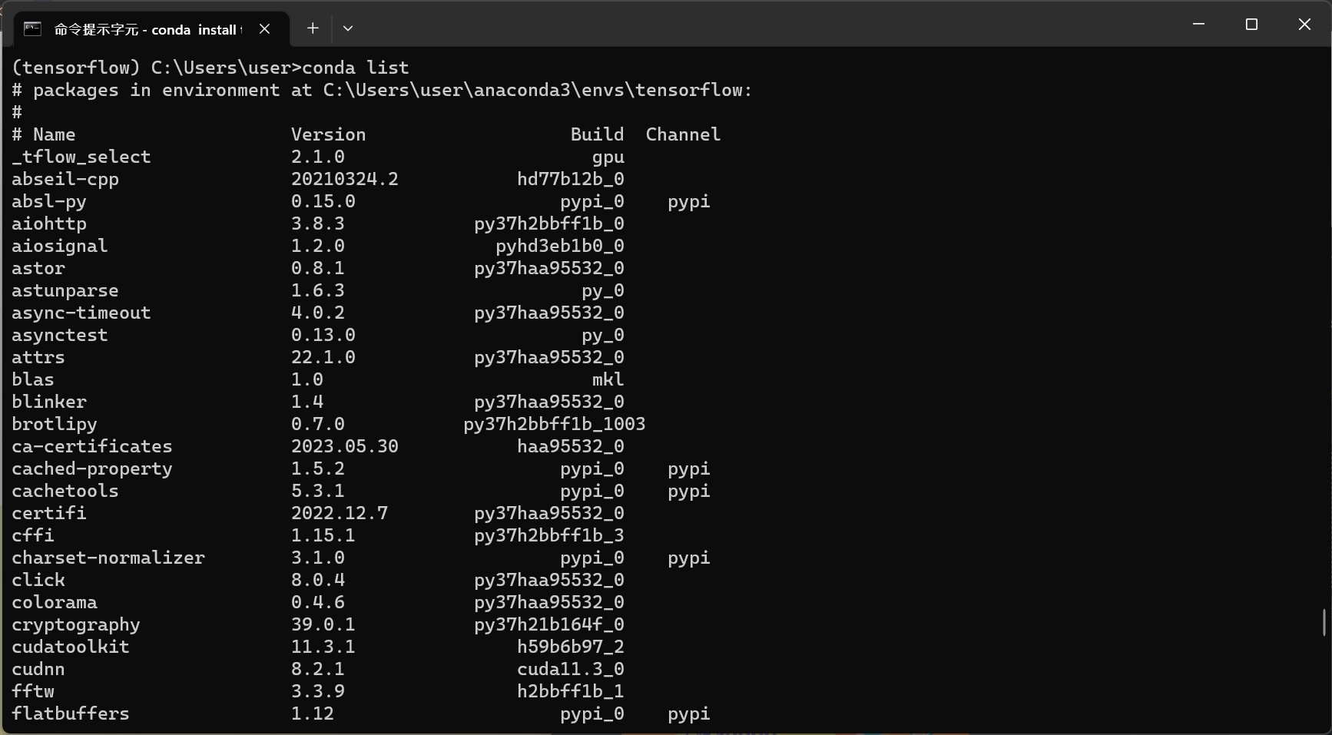
Tensorflow GPU Setup
4. conda list
確認cudnn、cudatoolkit皆已安裝及對應版本

Slide 13
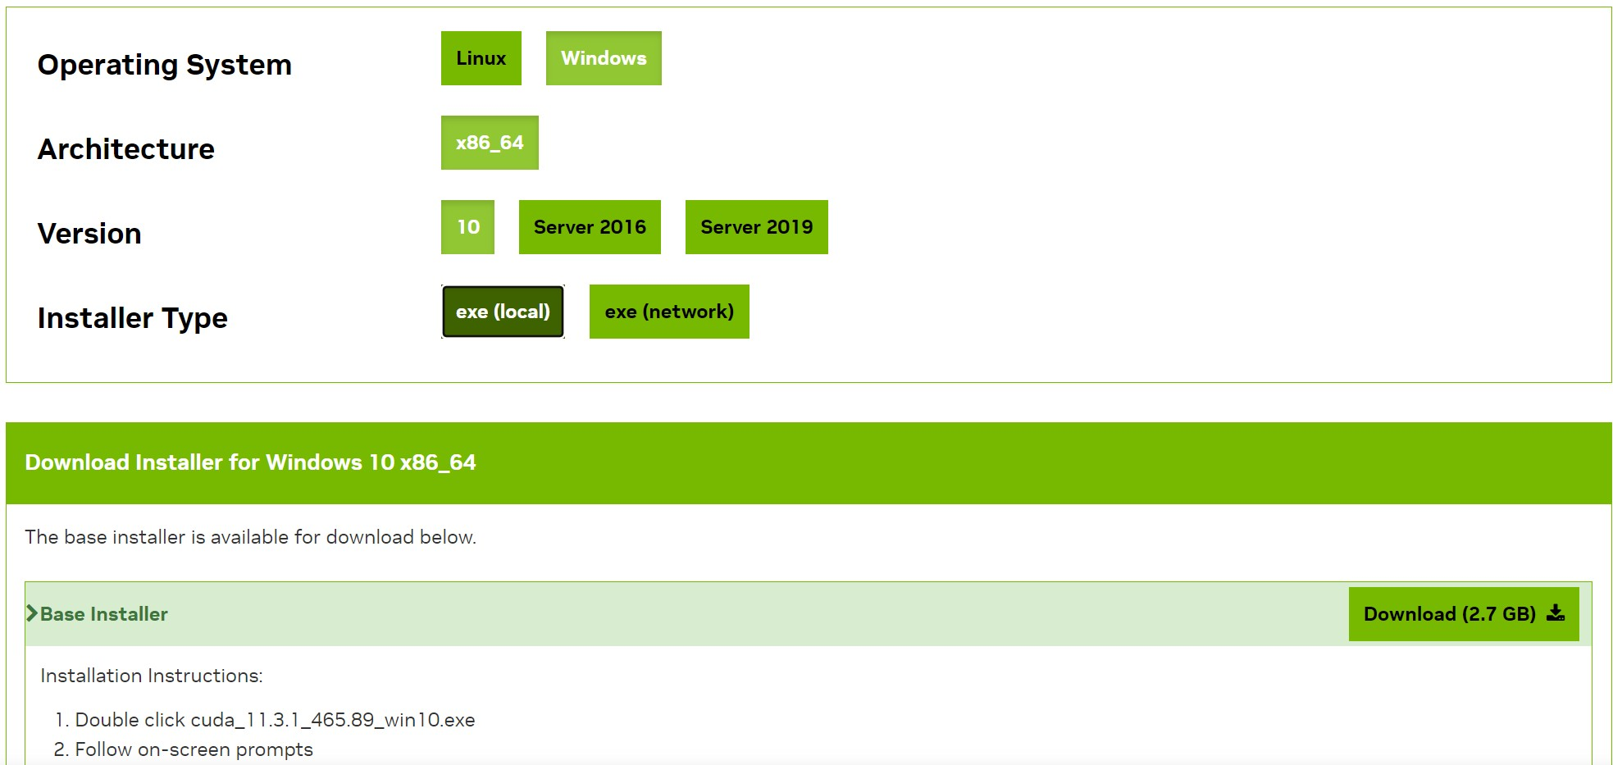
Tensorflow GPU Setup
5. 依照對應版本下載CUDA
CUDA 11.3.1 : https://developer.nvidia.com/cuda-11-3-1-download-archive

Slide 14
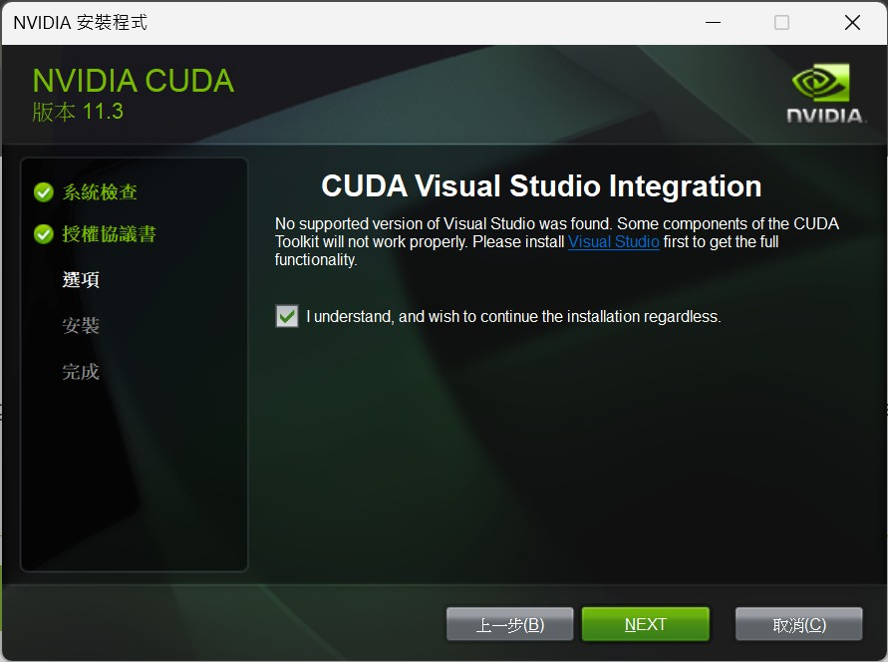
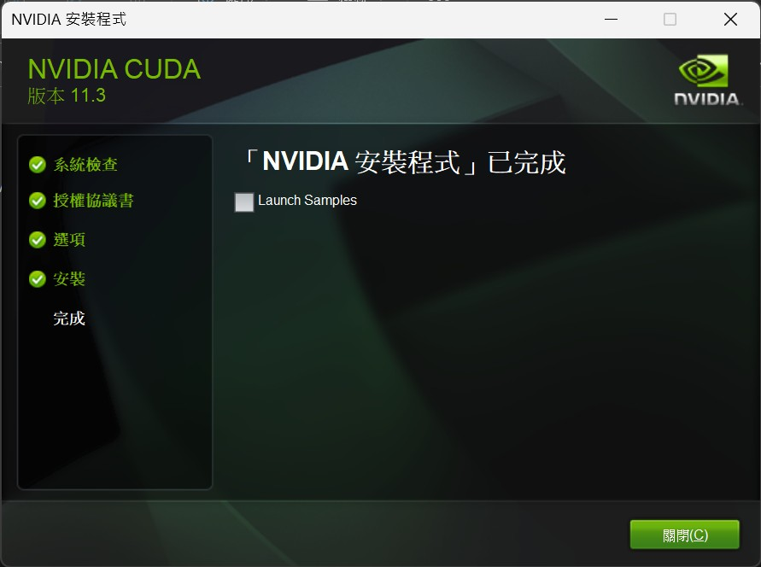
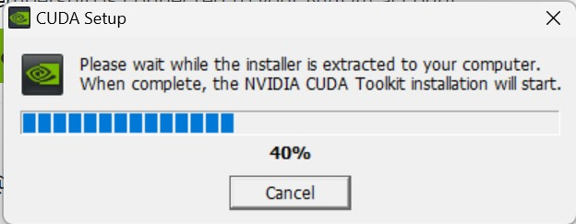
Tensorflow GPU Setup
CUDA setup

Slide 15
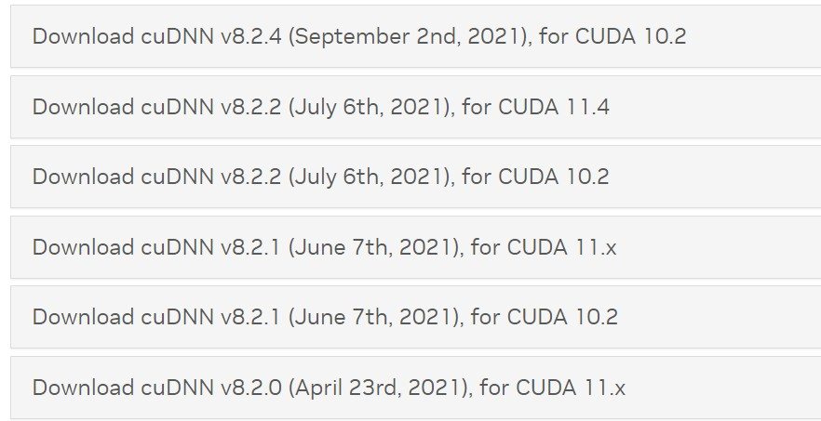
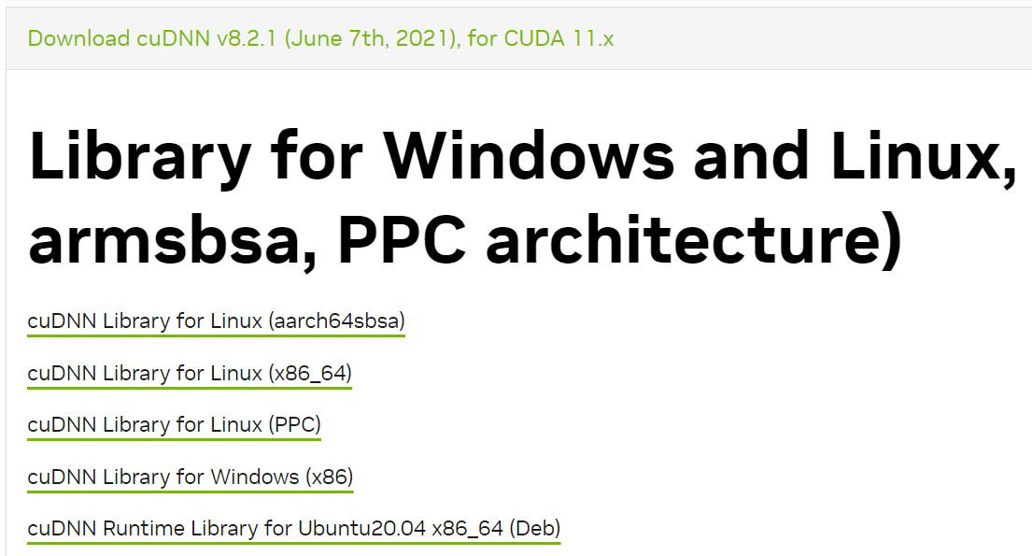
Tensorflow GPU Setup
6. 依照對應版本下載cuDNN (需登入NVIDIA)
cuDNN 8.2.1 : https://developer.nvidia.com/rdp/cudnn-archive
注意CUDA版本
Download Windows version

Slide 16
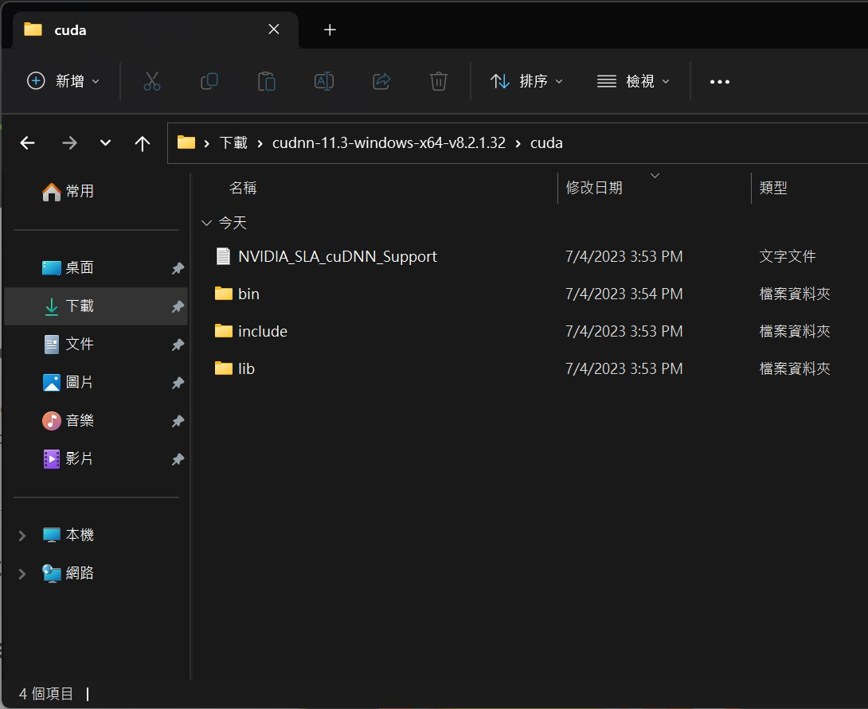
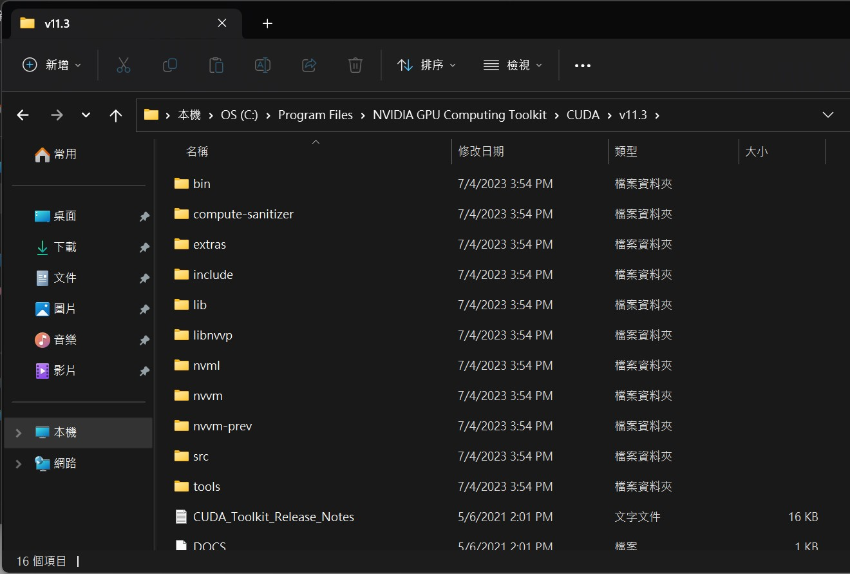
Tensorflow GPU Setup
CUDNN資料夾:
C:\Users\user\Downloads\cudnn-11.3-windows-x64-v8.2.1.32\cuda
CUDA資料夾:
C:\Program Files\NVIDIA GPU Computing Toolkit\CUDA\v11.3
將cudnn的
Bin
Lib
Include
資料夾中檔案(不是資料夾)複製到CUDA對應資料夾

Slide 17
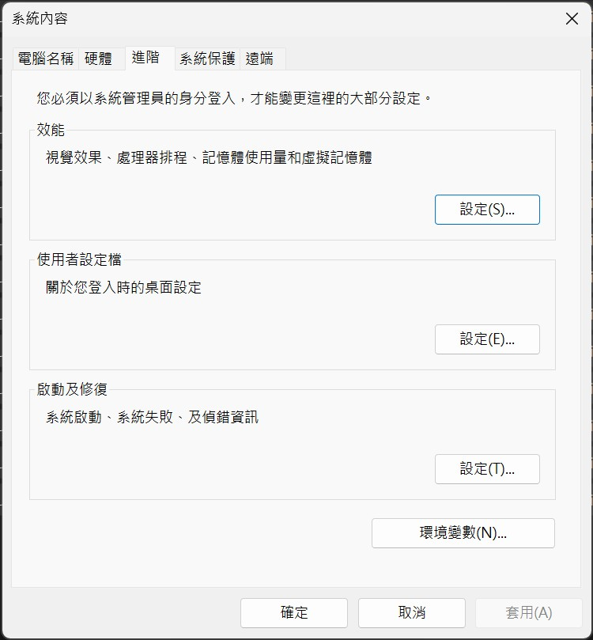
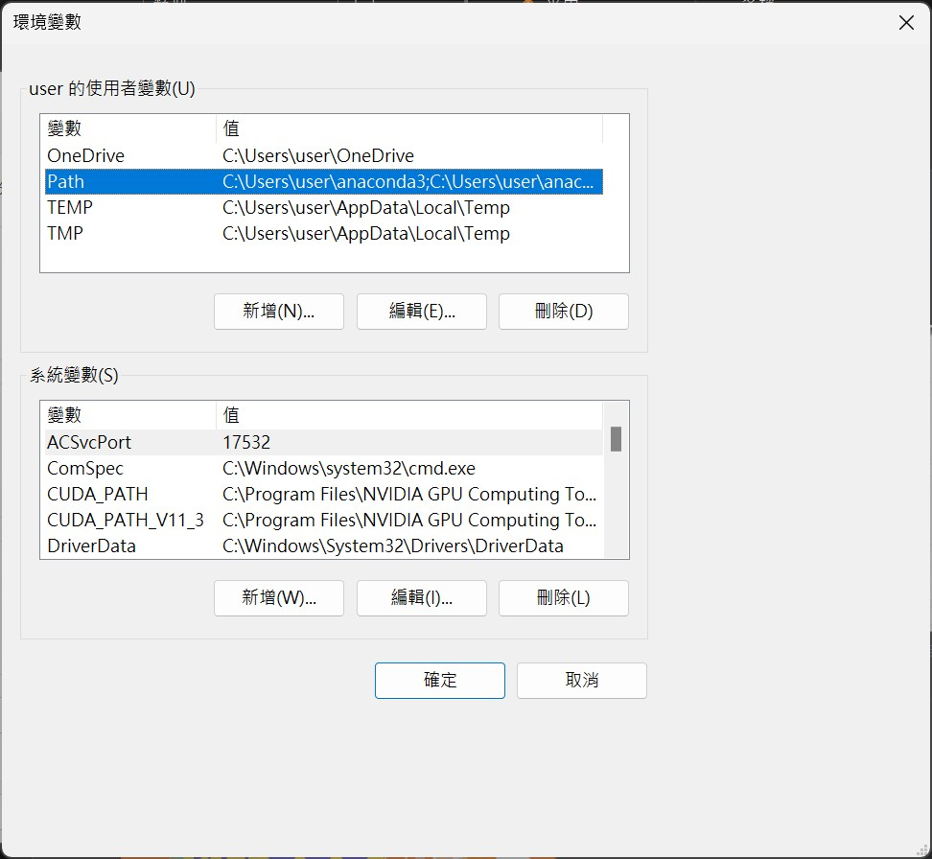
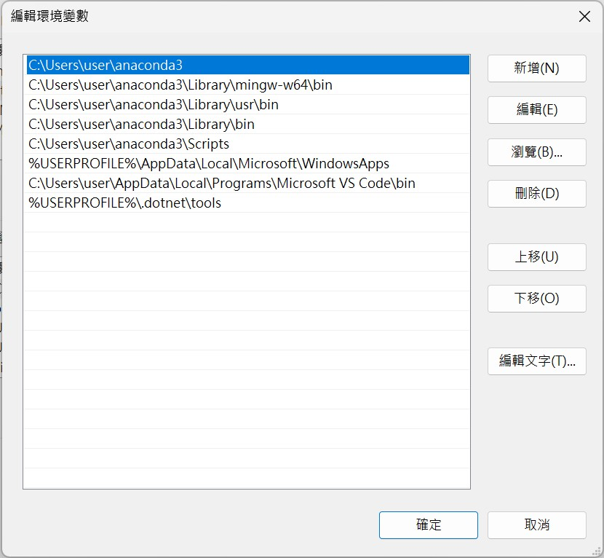
Tensorflow GPU Setup
7. 搜尋環境變數
點擊Path再按編輯

Slide 18
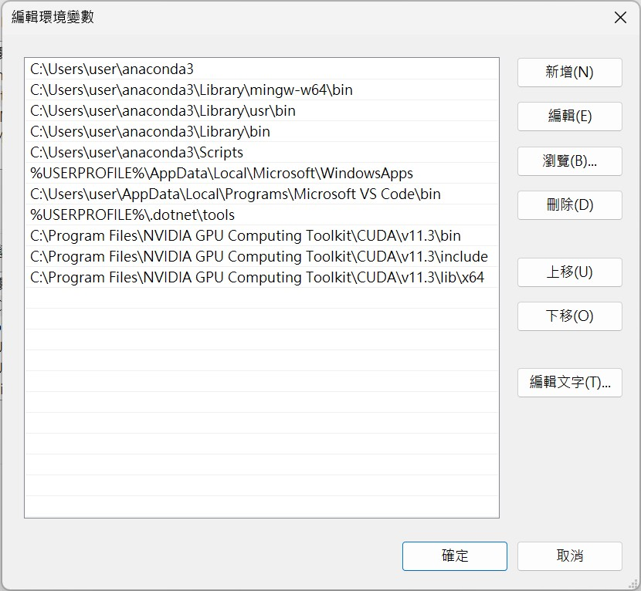
Tensorflow GPU Setup
8. 新增環境變數
C:\Program Files\NVIDIA GPU Computing Toolkit\CUDA\v11.3\lib\x64
C:\Program Files\NVIDIA GPU Computing Toolkit\CUDA\v11.3\bin
C:\Program Files\NVIDIA GPU Computing Toolkit\CUDA\v11.3\include

Slide 19
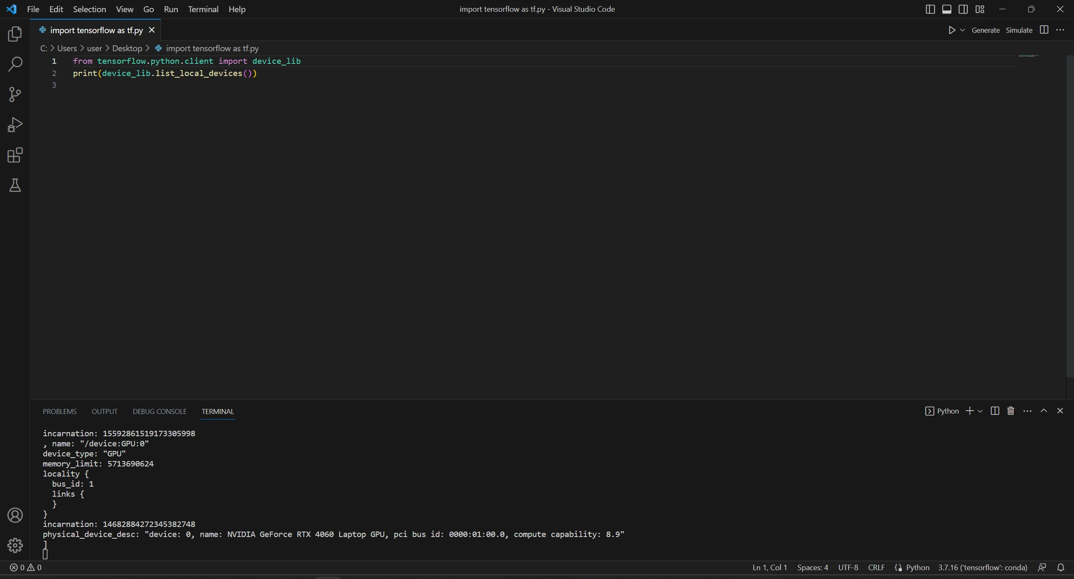
Tensorflow GPU Setup
9. 驗證 (在vscode上輸入)
from tensorflow.python.client import device_lib
print(device_lib.list_local_devices())
顯示出顯卡型號代表成功

